Slide 1
Internet & World Wide Web

Slide 2
Internet
• Internet is a network of the networks.
• It is a global network of computers.
• Internet is a collection of millions of computers around the world
that are all connected to one another.
• These computers are connected through different telecommunication links like:
Phone Lines.
Fiber Optics Lines.
Satellite and Wireless Connections.
• A computer connected to the internet will either act as a host or server or both.
• These computers uses a common protocol called TCP/IP for communication.

Slide 3
Internet.
• No government or organization is the owner of Internet.
• Many people, organizations, universities and research
agencies participates to run and the development of the
Internet.
• Different organization sets standards for the Internet .i.e.
IETF, ISO, IEEE etc.

Slide 4
History of Internet.
• The work on Internet was started during cold war of Russia and America.
ARPANET:
In 1957, during the Cold War, Russia launched Sputnik satellite and America developed a network known as ARPANET.
ARPANET was developed by ARPA.
ARPA worked on project to send information to armed forces at long distance.
Different organization and universities were involved in this research.

Slide 5
History of Internet.
DARPA:
Defense Advanced Research Project Agency was a new name for ARPA.
DARPA started work to share information not only on single network but also among different and scattered networks.
TCP/IP:
TCP/IP was developed by Stanford Research Institute.
It was designed to share and transfer data among different networks.

Slide 6
History of Internet.
Internet:
Internet is now the largest network in the world.
Millions of computers are connected together through different mediums.
Any computer with a modem and telephone line can become a part of the Internet.

Slide 7
Connection to the Internet.
Computer:
Any computer can be used for connection to Internet.
DSL Modem:
DSL modem is an electronic device that converts digital data form the computer to an analog form and vice versa.
ISP Connection:
ISP provides the link between the computer and the Internet.
A person has to get an account of an ISP for establishing a connection to the Internet.
Web Browser:
Web browser is a software that is used to view web pages .i.e. Internet Explorer and Netscape Communicator etc.

Slide 8
Uses of Internet.
• To access information, news, research and education material.
• To conduct business.
• To access sources of entertainment such as online games, magazines etc.
• To meet and talk with people around the world in discussion groups or chat rooms.
• To access other computers and exchange files.
• To send and receive E-mail messages.
• To shop for goods and services.

Slide 9
Uses of Internet
Emails
Instant messengers
Social networks
Professional networks
Blogs
Discussion forums

Slide 10
Advantages of Internet.
Information Search:
Internet contains information on all types of topics.
People can search information on any topic.
Search engines are used to search information on Internet .i.e. Google etc.
• E-mail:
E-mail is an inexpensive and fast way of communication.
It is used to send messages, pictures and files from one part of the world to another part.
• E-commerce:
People can use Internet for financial and business dealings.
A person can deal with his customers throughout the world.
• Fast Communication:
People can communicate with one another in less time from any part of the world

Slide 11
Disadvantages of Internet.
Security problems and Hacking :
Internet has created many security problems.
The hackers can access the important data stored on the computers across the Internet. They can use this data illegally or even destroy it.
Immortality.
Many immoral websites contains materials that is against the moral values of our society.
These websites are damaging the character of young people.
Viruses:
Most of the viruses spreads over the Internet either using Email or pictures etc.
Many websites also contain different viruses that are copied to the computers when the users download data form these website.

Slide 12
Disadvantages of Internet.
Wastage of Time:
Many people use Internet without any positive purpose.
The young people waste their time in chatting. It effects their performance and makes them inefficient.
Cyber Crimes:
Internet is the source of many cyber crimes.
The hackers, hacks the Credit Card Numbers of the people and can use them for shopping.
Some people uses Internet to spread illegal and immoral material.
Many governments are introducing laws to stop cyber crimes.

Slide 13
Service of Internet.
Word Wide Web:
It is a collection of documents or web pages stored on computers permanently connected with the Internet around the world.
A collection of related web pages is called website.
The web pages in a website are connected to one another using hyperlinks.
E-mail:
E-mail stands for Electronic Mail.
E-mail is the exchange of messages through Internet.
Message can be in the form of graphics, sound, video clips or simple text.
It is a fast way of delivering messages anywhere in the world in a very short time.

Slide 14
Service of Internet.
E-commerce:
Electronic commerce means to carry out financial and business dealings using Internet.
A person can deal with his customers throughout the world.
People can buy and sell goods on Internet, Even payment can be made using Credit Card numbers.
Telnet:
Telnet is a program that allows you to connect to a remote computer on the Internet.
After connecting, your computer acts like a terminal directly linked to the remote computer. You can make change in the computer configuration as that you can do local.
A Telnet program must be installed on your local computer and configured to your web browser in order to work.

Slide 15
Service of Internet.
File Transfer Protocol (FTP).
FTP is used for sending files from one place to another.
Audio, video, graphics and data files can be uploaded and downloaded using this protocol.
Different softwares like CuteFTP, WS_FTP uses this protocol for transferring files on the Internet.
Chatting and Instant Messaging:
Chat programs allow users on the Internet to communicate with one another by typing messages.
These programs can be either a single program like Yahoo
Massagner, MSN Massanger etc or included as a feature of a website, where users can log into the chat room to exchange comments and information.

Slide 16
The Web
The web refers to the World Wide Web, more commonly known as WWW.
It first came into being in 1989 when famous scientist and engineer, Tim Berners-Lee, came up with an efficient mechanism to share resources between scientists all over the world.
WWW has changed the way people communicate with each others and the way business is conducted
WWW is currently transforming the world toward a knowledge society
Most of today’s Web content is suitable for human consumption
Keyword-based search engines (e.g., Google) are the main tools for using today’s Web

Slide 17
WEB TECHNOLOGIES
Web technologies are the various tools and techniques that are utilized in the process of communication between different types of devices over the internet.

Slide 18
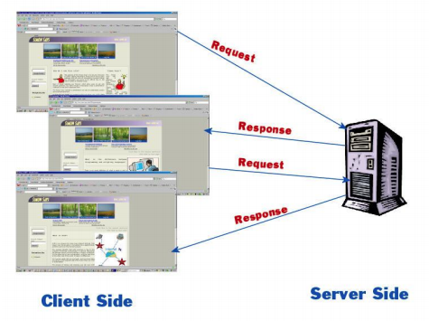
The Web is a client/server application
Web pages are stored in web servers, connected to the internet, to be made available to others
Web browsers are clients which send requests to Web servers, that sends back responses.

Slide 19
Web Essentials
Client: web browsers, used to surf the Web
Server systems: used to supply information to these browsers
Computer networks: used to support the browser-server communication
Request “document A”
document A
Client
Server

Slide 20
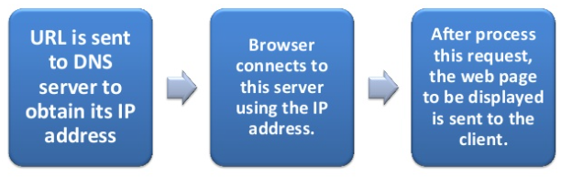
Communication on the WEB
The communication on the WEB require the devices or computers to understand each other. For doing so, all the communicating devices should follow the same set of rules called protocols. The protocol followed over the web is TCP/IP, commonly known as Internet protocol.
Websites are accessed through HTTP, whereas emails through SMTP (Simple Mail Transfer Protocol)

Slide 21
The Internet Protocol (IP)
A key element of IP is IP address, a 32-bit number
The Internet authorities assign ranges of numbers to different organizations
IP is responsible for moving packet of data from node to node
A packet contains information such as the data to be transferred, the source and destination IP addresses, etc.
Packets are sent through different local network through gateways
A checksum is created to ensure the correctness of the data; corrupted packets are discarded
IP-based communication is unreliable

Slide 22
Fetching Pages over the Internet
Architecturally, the Internet consists of a collection of layers, each one providing services for the one above it:
The Internet Layer gets packets to their destinations;
The Transport Layer sends streams of data;
The Application Layer provides high-level services to applications such as Web browsers.

Slide 23
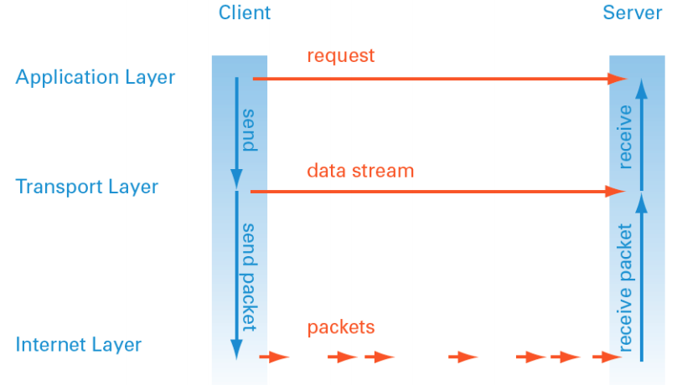
Fetching Pages over the Internet
Internet Protocol Layers

Slide 24
The Transmission Control Protocol (TCP)
TCP is a higher-level protocol that extends IP to provide additional functionality: reliable communication
TCP adds support to detect errors or lost data and to trigger retransmission until the data is correctly and completely received and acknowledged

Slide 25
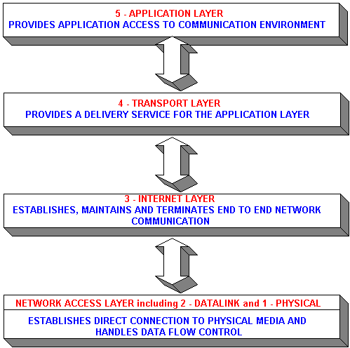
TCP/IP Protocol Suites
HTTP, FTP, Telnet, DNS, SMTP, etc.
TCP, UDP
IP (IPv4, IPv6)

Slide 26
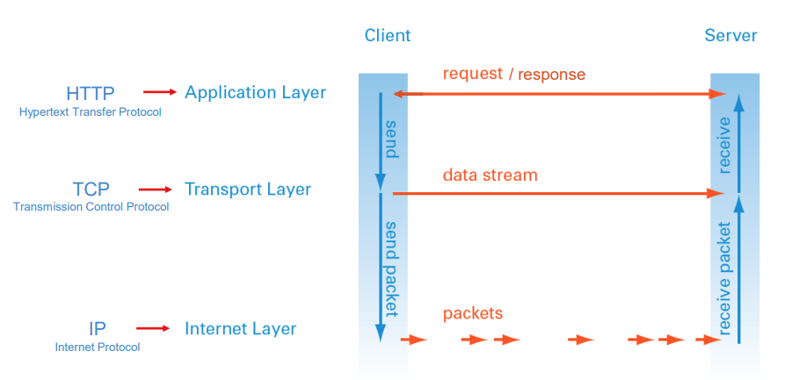

Slide 27
HTTP
HTTP makes use of TCP to open connections between clients and servers and to pass the requests and responses between them.
When a user clicks a link or types a web address:
A TCP connection is opened between browser and server
Then requests and responses are sent back and forth using HTTP.
HTTP is a stateless protocol, meaning each request for data is dealt with in isolation; once the server sends the response, it forgets everything about the original request.

Slide 28
Basics of the WWW
Hypertext: a format of information which allows one to move from one part of a document to another or from one document to another through hyperlinks
Uniform Resource Locator (URL): unique identifiers used to locate a particular resource on the network
Markup language: defines the structure and content of hypertext documents

Slide 29
Web Client: Browser
Makes HTTP requests on behalf of the user
Reformat the URL entered as a valid HTTP request
Use DNS to convert server’s host name to appropriate IP address
Establish a TCP connection using the IP address
Send HTTP request over the connection and wait for server’s response
Display the document contained in the response
If the document is not a plain-text document but instead is written in HTML, this involves rendering the document (positioning text, graphics, creating table borders, using appropriate fonts, etc.)

Slide 30
Web Servers
Main functionalities:
Server waits for connection requests
When a connection request is received, the server creates a new process to handle this connection
The new process establishes the TCP connection and waits for HTTP requests
The new process invokes software that maps the requested URL to a resource on the server
If the resource is a file, creates an HTTP response that contains the file in the body of the response message
If the resource is a program, runs the program, and returns the output

Slide 31
Uniform Resource Locators (URLs)
Without a universal addressing mechanism, it would be impossible to navigate to a site, and page linking would not be feasible
Uniform Resource Locators (URLs) are used to identify Web pages
basically a URL is a web address URLs have 3 components:
A Prefix (usually http:// )
A Hostname: (such as www.cityu.edu.hk)
A Path: (such as /scm/index.htm)

Slide 32
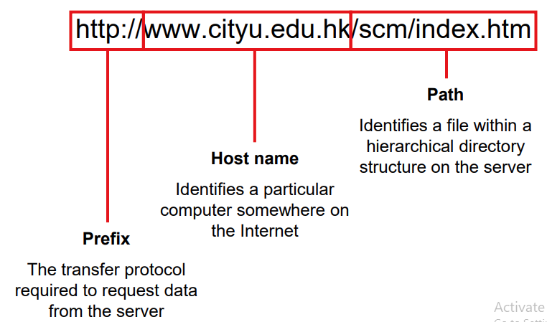
Uniform Resource Locators (URLs)

Slide 33
IP Addresses and DNS
Every computer connected to the Internet must have a unique IP address, no matter whether it’s a client or a server (or both)
An IP address is just a number that identifies a host on the Internet.
Example:
212.171.218.34 or
144.214.5.218
The Domain Name System (DNS) is a database that matches IP addresses to host names

Slide 34
Domain Name
The Domain Name System (DNS) translates host names into IP addresses, which are then used by TCP to establish connections between HTTP clients and servers.
Domain names are administered in such a way that they are guaranteed to be unique. Domain names are organized in a hierarchical structure.

Slide 35
Domain Name
Top Level Domain (TLD) Mostly country domains: .uk, .au, .hk, etc.
www.uop.edu.pk
Generic Top Level Domain (gTLD) .com .org .net .biz .info .tv
www.Samsung.com
Second level domain: The actual name of the organization or service. Can contain letters (a to z), numbers (0 to 9), dashes
Third Level, or Sub Domains: Strings of characters that designate different services, or hosts within the second level domain. For example, “www” for the core or main website.

Slide 36
Linking Domain Names and IP Addresses
A domain name, once registered, needs to be associated with a fixed IP address of a web server on the Internet. When you register and setup a new domain name, you need to enter details of at least 2 nameservers. These nameservers are special internet servers that implement a name service protocol. They may be provided by a web hosting service, or a domain registration service. They link a domain name to the specific IP address assigned for a website.
Most commercial hosting services provide a form of virtual hosting, placing many websites on a single server, so special software is used to route domains names to assigned IP address.

Slide 37
Path name
A pathname shows the hierarchical directory structure and location of a specific file or resource on a server.
Example
http://www.uop.edu.pk/departments/?q=Department-of-Computer-Science

Slide 38
Static Web: HTML/XHTML, CSS
HTML stands for HyperText Markup Language
It is a text file containing small markup tags that tell the Web browser how to display the page
XHTML stands for eXtensible HyperText Markup Language
It is identical to HTML 4.01
It is a stricter and cleaner version of HTML
CSS stands for Cascading Style Sheets
It defines how to display HTML elements

Slide 39
Client-Side Programmability
Scripting language: a lightweight programming language
Browser scripting: JavaScript
Designed to add interactivity to HTML pages
Usually embedded into HTML pages
What can a JavaScript Do?
Put dynamic text into an HTML page
React to events
Read and write HTML elements
Validate data before it is submitted to a server
Create cookies
…

Slide 40
Server-Side Programmability
The requests cause the response to be generated
Server scripting:
CGI/Perl: Common Gate Way Interface (*.pl, *.cgi)
PHP: Open source, strong database support (*.php)
ASP: Microsoft product, uses .Net framework (*.asp)
Java via JavaServer Pages (*.jsp)
…

Slide 41
The World Wide Web (WWW)
WWW is a system of interlinked, hypertext documents that runs over the Internet
Two types of software:
Client: a system that wishes to access the information provided by servers must run client software (e.g., web browser)
Server: an internet-connected computer that wishes to provide information to others must run server software
Client and server applications communicate over the Internet by following a protocol built on top of TCP/IP – HyperText Transport Protocol (HTTP)

Slide 42
Basic Terminologies of Internet.
Website:
A collection of related web pages that you can access electronically is called website. It contains text, graphics, sound and video.
Home Page:
Home page is the starting point of a web site. It normally provides information about the site’s purpose and content.
Hyper Link:
Hyper link is simply a part of text or graphics on a web page that is when clicked will either take the user to a different part of the same page or to a different page within or out side of the website etc.
Frames:
Frames are used to divide a web page into different parts.
Different web pages can be displayed in each part.

Slide 43
Basic Terminologies of Internet.
HTTP:
HTTP is the protocol used to make web requests (web page on the Internet).
HTML:
HTML is the fundamental language to design web pages.
Webmaster:
A person who develops and maintains a website.
ISP:
ISP is a company that provides a connection between the user’s computer and the Internet.
The common type of connection is dial-up using modems on normal telephone lines.
ISP provides the facilities like FTP and E-mail.
Examples are Comsats, Brain Net etc.

Slide 44
Web Browser.
A web browser is an application software that acts as an interface between the user and the Internet.
It has the capability to understand HTML.
It can display text and graphics.
Browsers are also known as web clients or universal clients.
Two types of browsers:
Text-based Browsers:
It displays only textual information, not graphics.
Text is all of the same size and can only be either underlined or boldface.
It supports only keyboard to move in the web page. It does not support mouse.
Example is Lynx.
Graphical Browsers:
It can display both text and graphics.
Web page contents can be formatted in any way and colors.
It supports both keyboard and mouse for user interaction.
Examples are Internet Explorer and Netscape Communicator.

Slide 45
Web Server.
Web server is a software running on a computer much faster and powerful than an ordinary PC computer.
Commonly the computer running with web server software is called web server.
Web server shares the web pages stored on the web server computer among the users upon request.
Web server computer can be located anywhere in the world and is connected to the Internet 24 hours a day.
A web server can host any number of websites depending on its performance.
A web server receives a web request form a web browser and responds with the contents of the page requested.
The contents of a page is described in HTML.

Slide 46
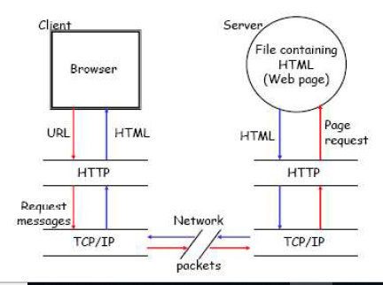

Slide 47
Search Engine.
Internet is an important source of informations. A large number of websites provides informations about different topics.
Search engine is a website working with a very vast and rich database, that provides the ability to find the required website on a particular topic.
Search engine contains record of different websites and display the relevant websites to the users depends on the topic they are interested in.
Some popular search engines are:
www.google.com.
www.altavista.com.
www.hotbot.com.
www.excite.com

Slide 48
Types of Websites.
Portal
Portal is a website that provides different types of Internet services such as:
Search engine
News.
Sports and Weather.
Stock quotes.
Shopping malls.
Auctions.
Emails.
Online communication.
The common portal is YAHOO!, Alta Vista, AOL, MSN.

Slide 49
Types of Websites.
News:
News websites provides different types of news related to current affairs, politics, sports and weather etc.
Popular magazines and news papers provide news on their websites.
Examples are:
www.geo.com.
www.jang.com.pk.
Informational:
Informational websites provides information with facts and figures.
Governments provides information about different departments and policies for general public.
Examples are:
www.pakistan.gov.pk.
www.hec.gov.pk.

Slide 50
Types of Websites.
Business/Marketing.
Business/Marketing websites provides material to promote products and services.
Most companies have their own sites. The customer can view the products and interact with the company.
Most companies also provides the facilities of online shopping using Internet.
Examples are:
www.dell.com.
www.ibm.com.
Educational:
Educational institutions provides their informations on their sites.
They provides informations related to teaching and learning.
Some websites also provides online training classes.
Universities provides information about their classes, courses, admissions, results on their website.
Examples are:
www.nu.edu.pk.
www.uop.edu.pk.

Slide 51
Types of Websites.
Entertainment
Entertainment websites provides material for enjoyment. They provides information about movies, music, sports, games and chats etc.
Some website provides online shows, live sports etc.
Examples are:
www.lollywood.com.
www.pakistanmusic.com.
Advocacy:
Advocacy websites provides material to convince people of a cause, opinion or idea.
Examples are : NGO’s websites.
• Personal:
Personal websites contains material of an individual or a family.
People publish personal website to share their life, views etc with others.
Examples are : websites of researchers, actors, players

Slide 52
Web Pages Types.
Two types of web pages:
Static web pages:
Static web pages are those pages whose contents does not changes with the passage of time or they will show the same contents each time it has been visited until or unless they are changed by the web author.
Dynamic web pages:
Dynamic web pages are those pages whose contents changes with the passage of time or they will show different contents each time it has been visited.
They changes their content automatically

Slide 53
Scripting Languages.
Scripting languages are used to provides programming capabilities to a web page.
Scripting language can be divided into TWO types:
Client-Side Scripting Languages:
The Script that is executed on the client machine is called client-side scripting.
Languages used for client-side scripting are:
JavaScript.
VBScript.
Server-Side Scripting Languages:
The script that is executed on the server machine.
Languages used for server-side scripting are:
Active Server Pages.
Servlet.
PERL CGI.

